Slide 1







Engineering electrical stimulation of the human brain
David Caldwell
Thesis Defense - Bioengineering
Ojemann and Rao Laboratories
5.15.2019

Slide 2
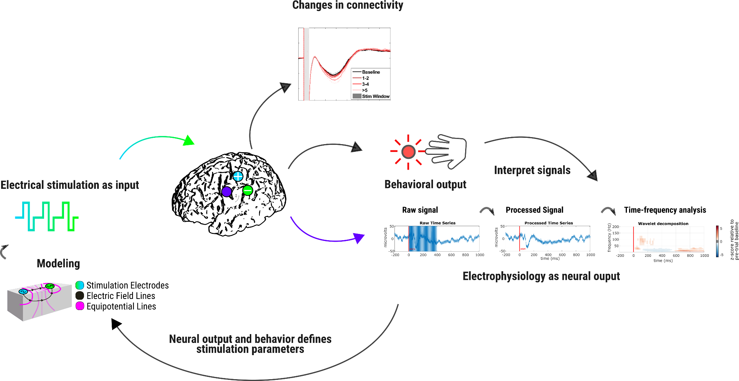
Thesis
Approach: Direct cortical stimulation (DCS) in humans through implanted electrodes can be engineered through:
Goal: To help engineer functional neuroprosthetics for sensory restoration and plasticity enhancement
Interpretation of the underlying cortical dynamics during and in response to stimulation
Models of its spread through cortex
Impact on neuronal plasticity

Slide 3
Outline
Introduction
Clinical need
Relevant physiology
Direct cortical stimulation
Aims Overview
Aim 1: Modeling cortical stimulation and interpreting its effects on neural dynamics
Aim 2: Neural and behavioral effects of cortical stimulation in sensory cortex
Aim 3: Engineered DCS protocols to induce changes in cortical connectivity, plasticity, and motor output mapping

Slide 4
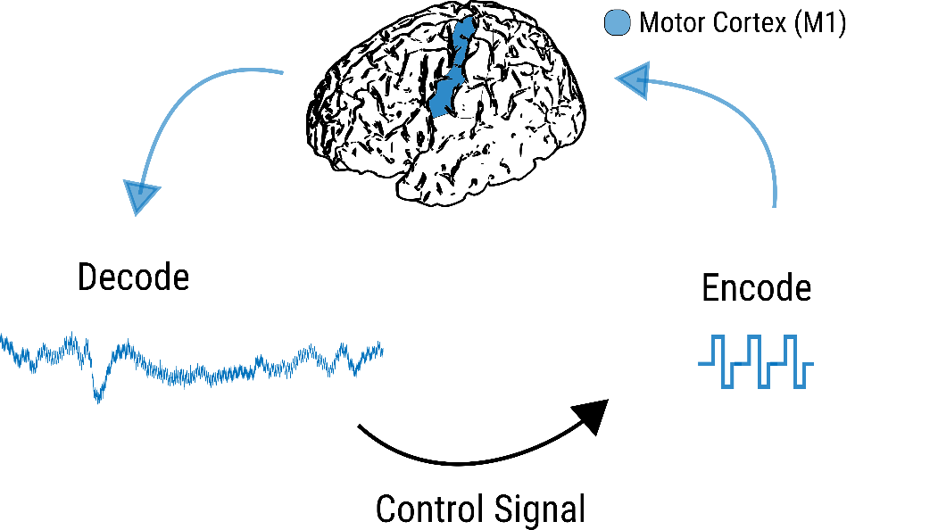
Motor deficits
Millions disabled from stroke
$34 billion - US/year
15-30% permanently disabled
Neuromodulation may be able to help over rehabilitation therapy alone
Stroke Facts | cdc.gov. 2016
Harvey RL, Winstein CJ. 2009
Lloyd-Jones D, et al. 2010

Slide 5
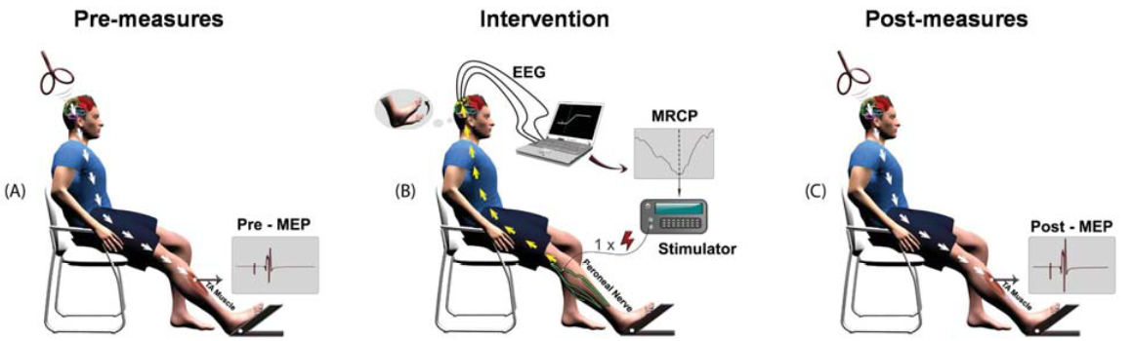
Prior human stroke rehabilitation
EVEREST Clinical trial 2008
Recovery of upper limb function following stroke
Epidural stimulation during rehabilitation
Discontinued - recent post hoc analysis suggests certain sub groups DID benefit
Was “open loop”
BCI training and stimulation
22 chronic stroke patients
Activity timed peripheral nerve stimulation
Effective neuroplastic induction
Better rehabilitation outcome than BCI alone
Levy et al. 2016
Mrachacz-Kersting N, et al. 2015

Slide 6
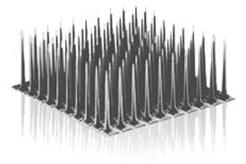
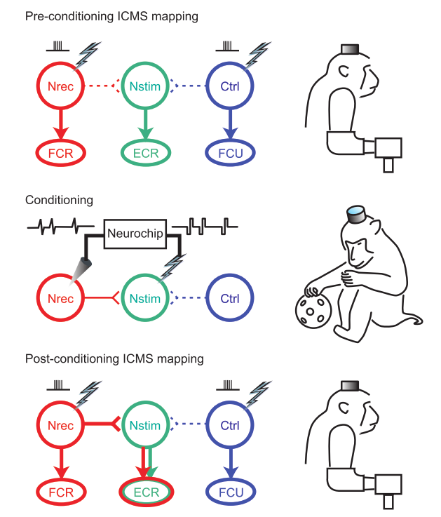
Motivated by activity dependent stimulation resulting in increased synaptic plasticity
Appropriate timing of stimulation
Muscle activity
Neural rhythm
Increase in connectivity strength¹
Correlate with functional outcome?²
Jackson A, Mavoori J, Fetz EE. 2006
Guggenmos, et al, 2013
Blackrock Neuro Med

Slide 7
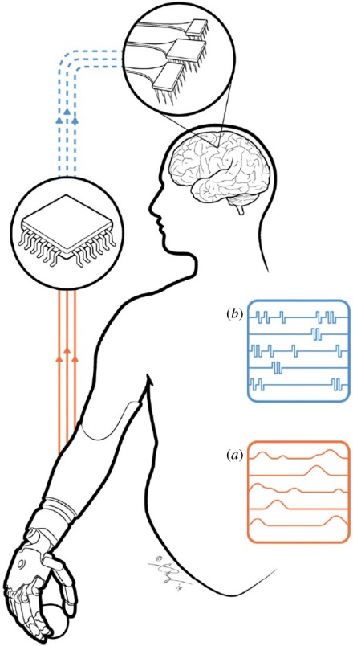
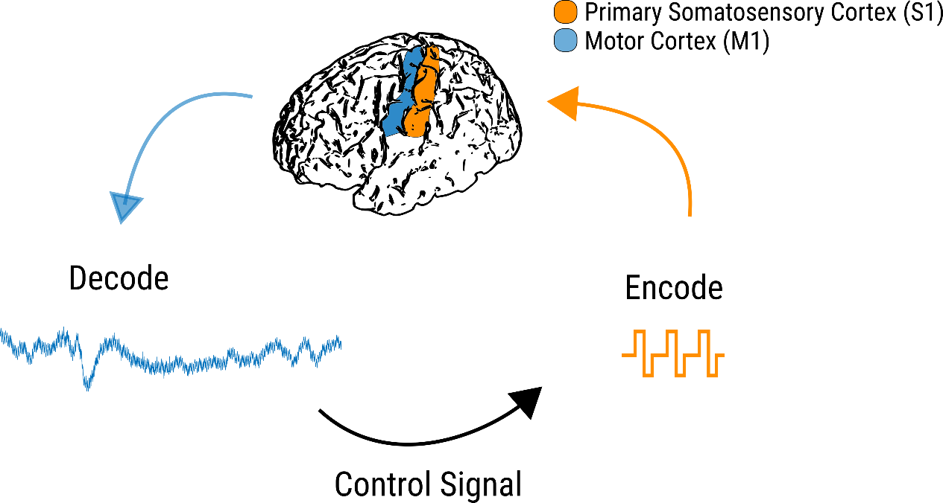
Sensory deficits and restoration
Millions of individuals disabled due from paralysis
$40.5 billion US/year
For better neuroprosthetic performance, need sensory feedback
Chris Reeves Foundation
Bensmaia, SL, et al. 2014
Bensmaia, SL, et al. 2015

Slide 8
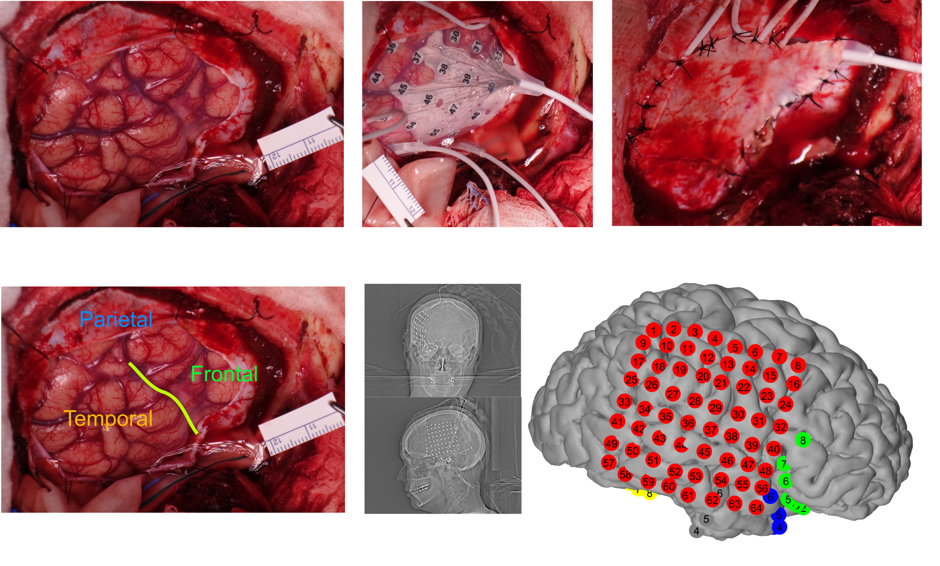
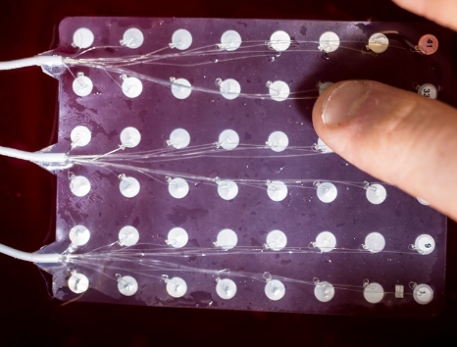
Electrocorticography (ECoG)
2.3 mm radius
4.15 mm² area
1cm apart
Subdural implanted electrode array for epilepsy monitoring for one week prior to resection surgery
Record and stimulate
High quality signals from inside the skull
Direct measurements of electrical signals

Slide 9
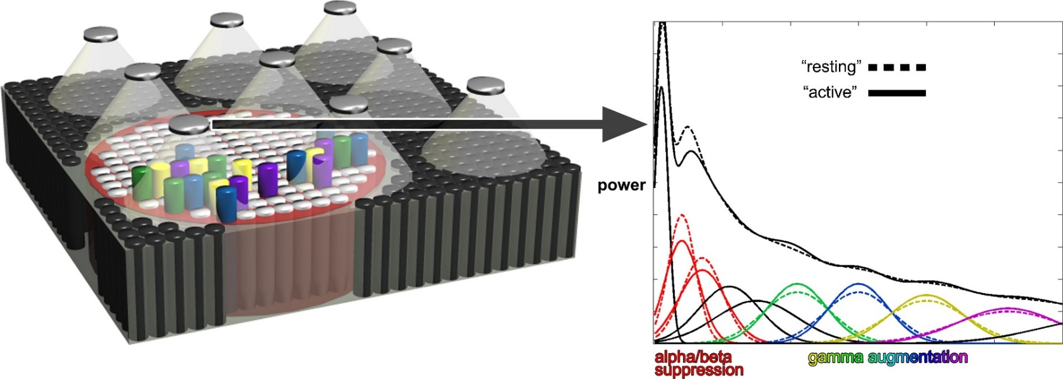
Signals measured via ECoG
Slower oscillatory activity
Theta (4-8 Hz), Alpha (8-12 Hz), Beta (12-30 Hz)
Pulsed inhibitory activity, global communication
Broadband gamma activity (HG)
Spectrum wide increase, masked in lower frequencies
Focal neuronal activity
Lachaux J, et al, 2012

Slide 10
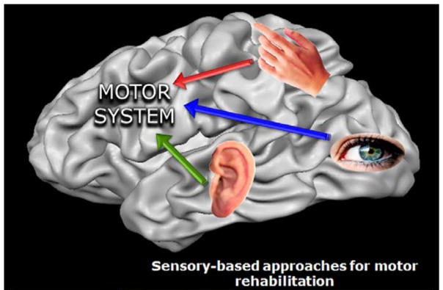
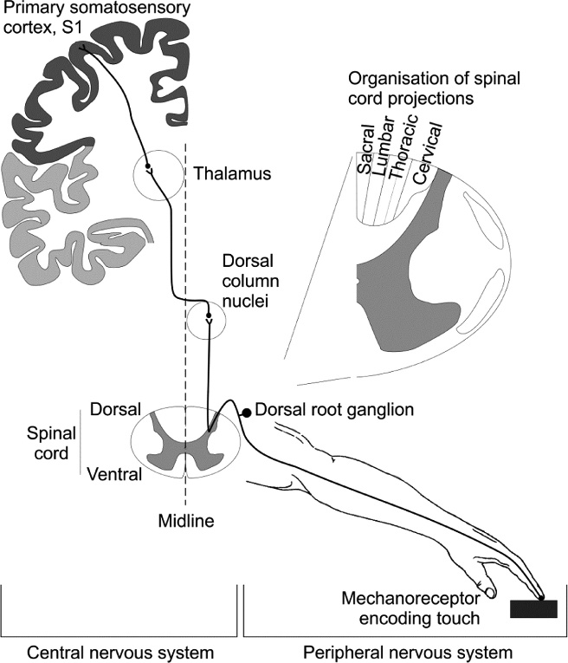
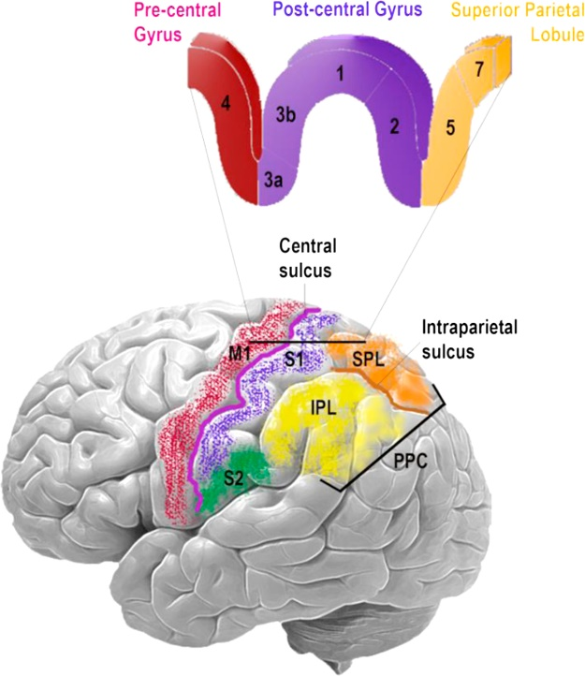
Sensory processing, artificial feedback, and links to motor cortex
Natural Touch
Interplay between motor and sensory
Electric stimulation
Ackerley R, et al, 2015
Bolognini N, et al, 2016

Slide 11
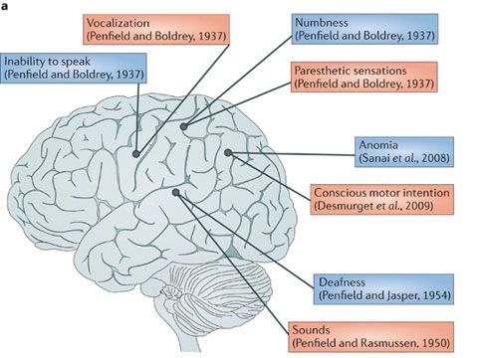
Neural effects of DCS
Complicated physiology
Large axons stimulated first
Axons preferentially over cell bodies
Sometimes excitatory, sometimes inhibitory
Allows for direct interface with brain
Borchers S, et al, 2012
Vincent M, et al, 2016

Slide 12
Aim 1.1: Creation of interpretable, analytic models that explain the resistivities of various cortical layers
Can we make a simple model that allows for rapid understanding of the current flow during electrical stimulation?
Yes - Simple analytic model describes the data well (8 subjects thus far)
Range of literature values for cerebrospinal fluid, gray matter, white matter
Important for source modeling, EEG, LFP propagation
Forward finite element models (FEM) for patient specific stimulation
Contributes to field of targeted neuromodulation, and any modeling efforts using cortical layers
Aim 1: Modeling cortical stimulation and interpreting its effects on neural dynamics

Slide 13
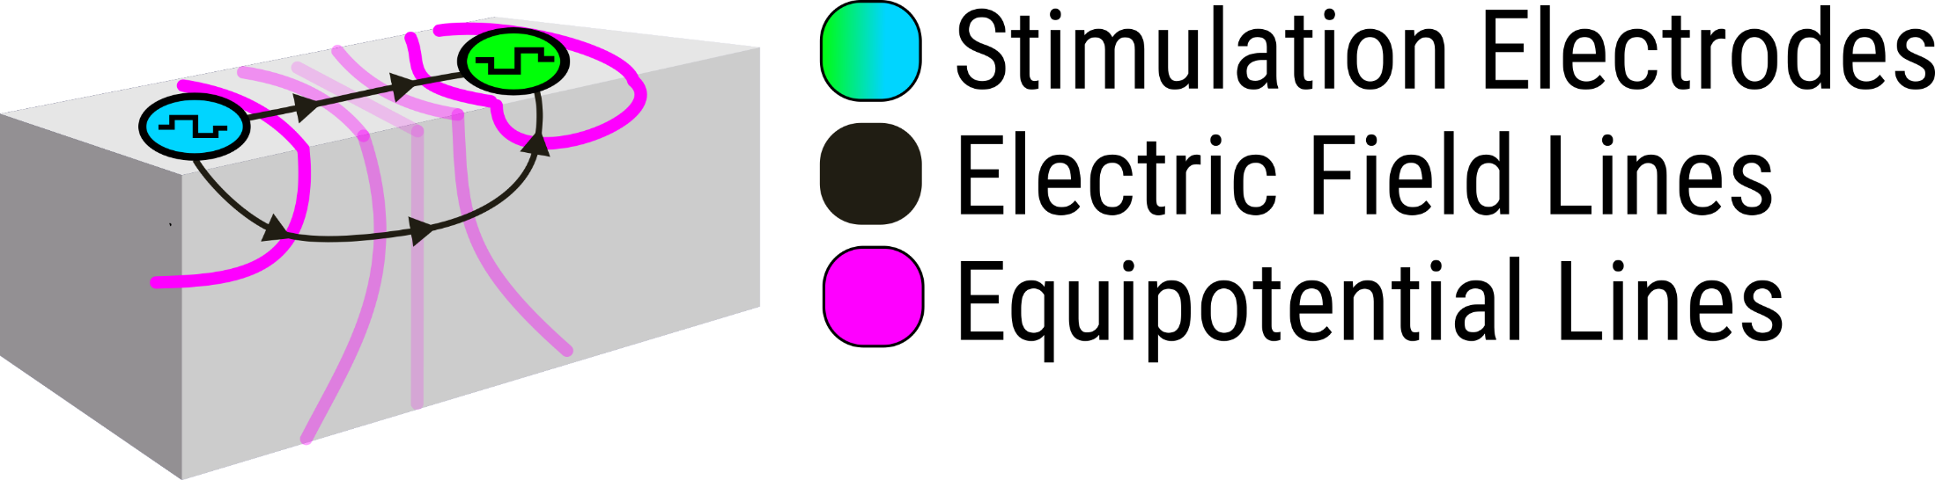
Where do the currents go?
Bipolar, phasic electrical stimulation
Currents flow along electric field lines perpendicular to the equipotentials
With Larry Sorensen, Jeneva Cronin, Stephen Reinertson, Brandon Yee, Dana Brooks, Moritz Dannhauer, Kimia Shayesterhfard, Rob MacLeod, and others

Slide 14
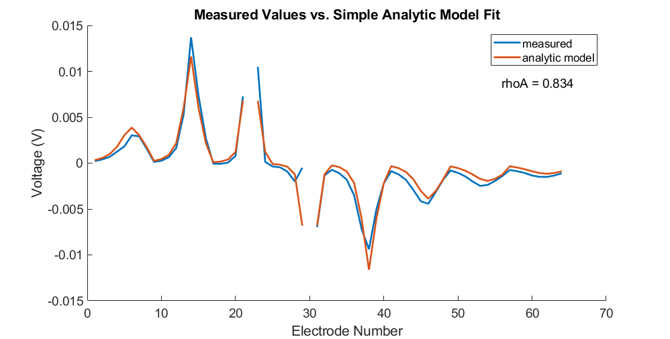
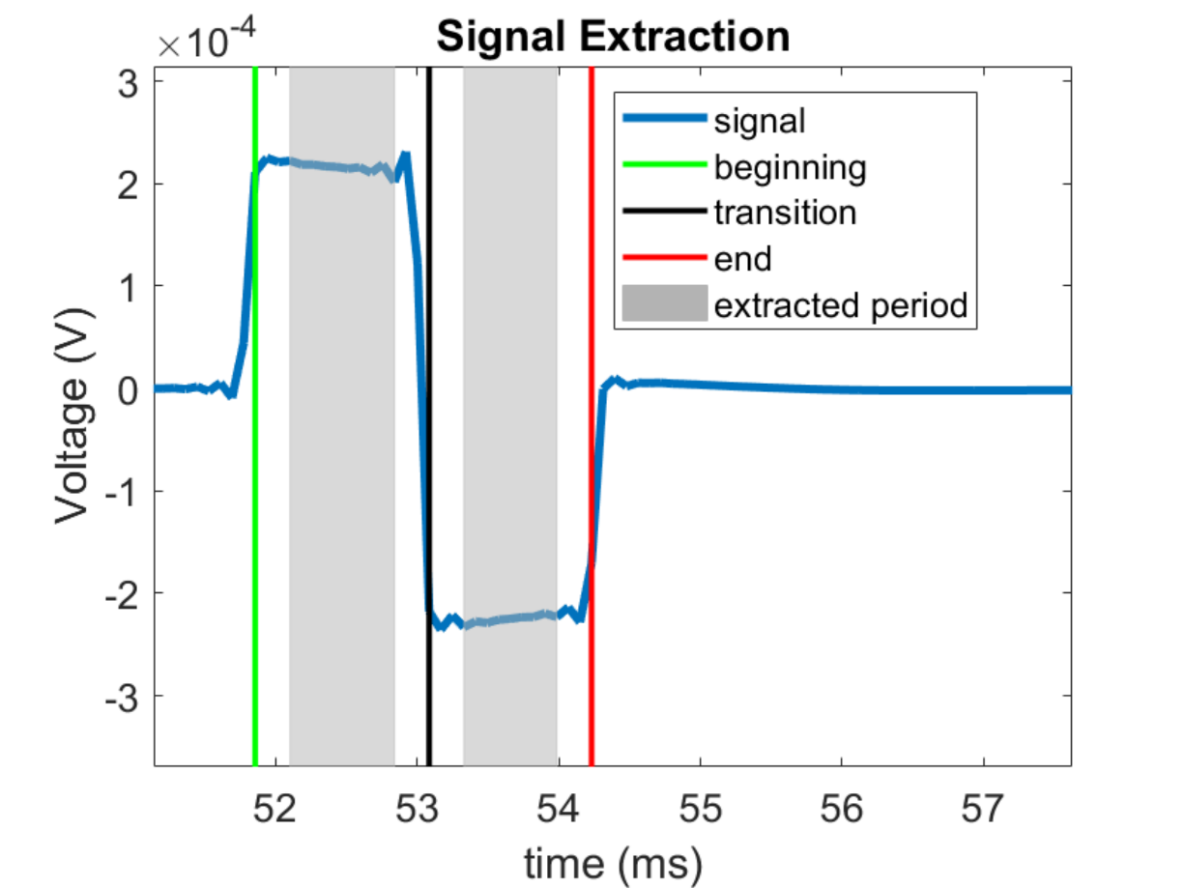
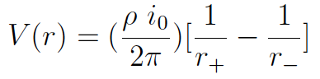
One layer apparent resistivity fits
Simple models fit well
Extract “steady state” voltage
Simple dipole model
Compare to collaborators Finite Element Models (FEM)

Slide 15
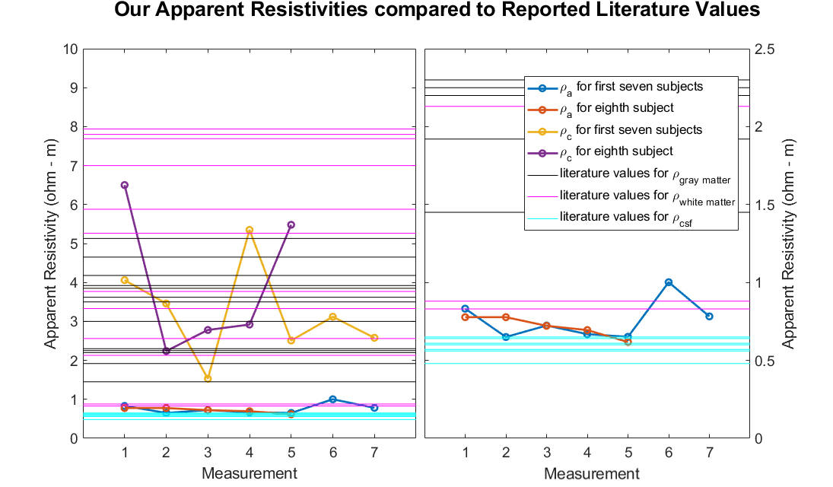
Results across subjects and comparisons to the literature
Caldwell DJ, et al, “What is the resistivity of the human brain? Insights from direct electrical stimulation, electrocorticographic recordings of the human cortex, and analytic models”, BMC Neuroscience 2018, CNS 2018

Slide 16
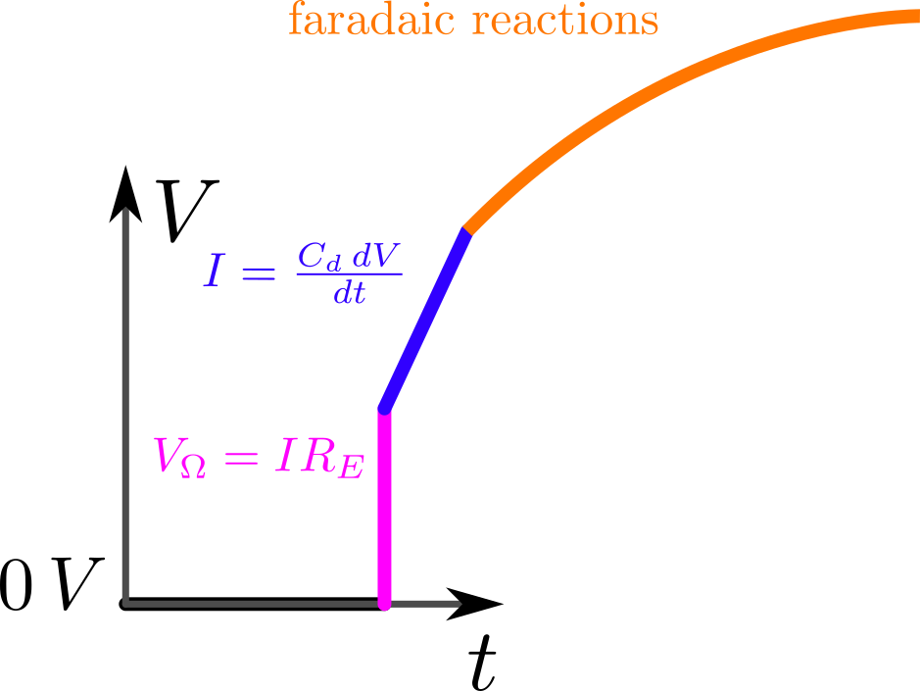
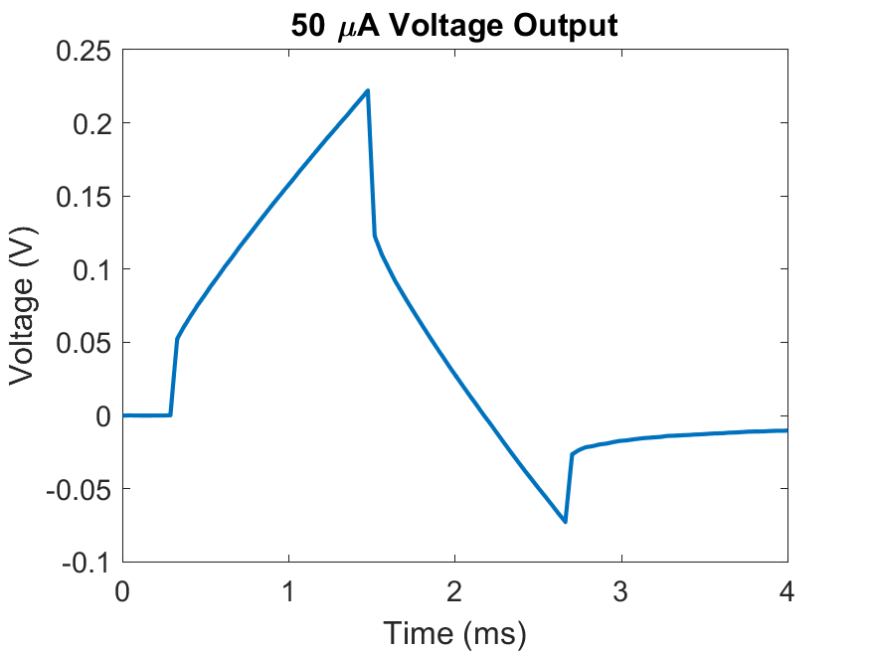
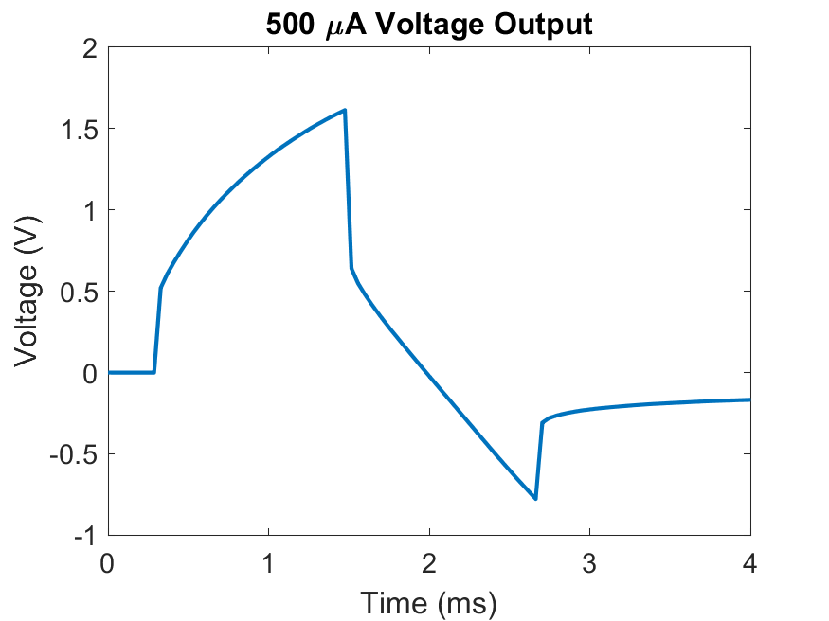
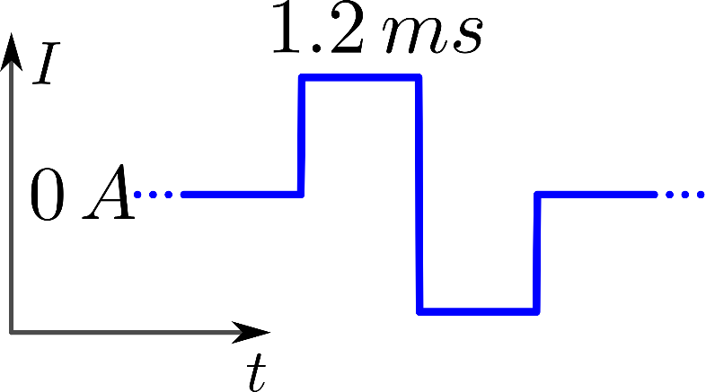
Characterizing ECoG electrodes
Charging double-layer capacitance
Capacitance + electrochemistry

Slide 17
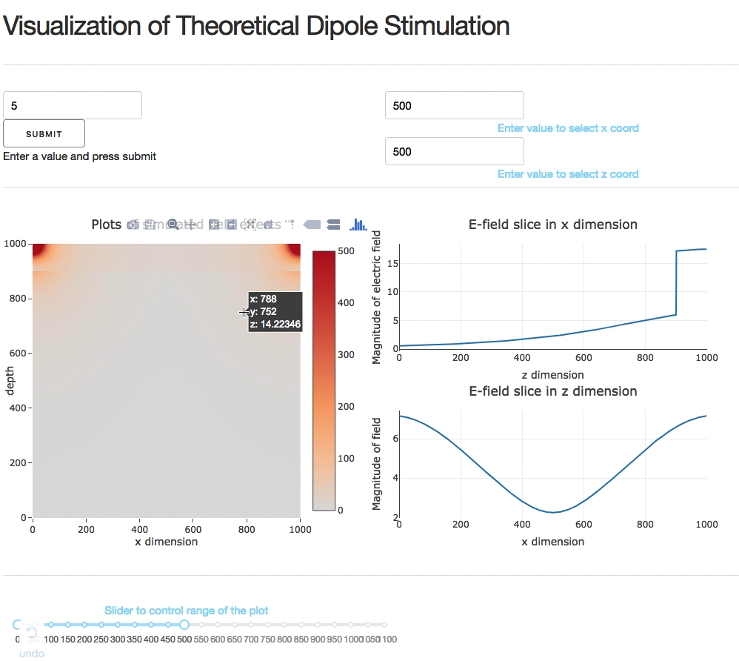
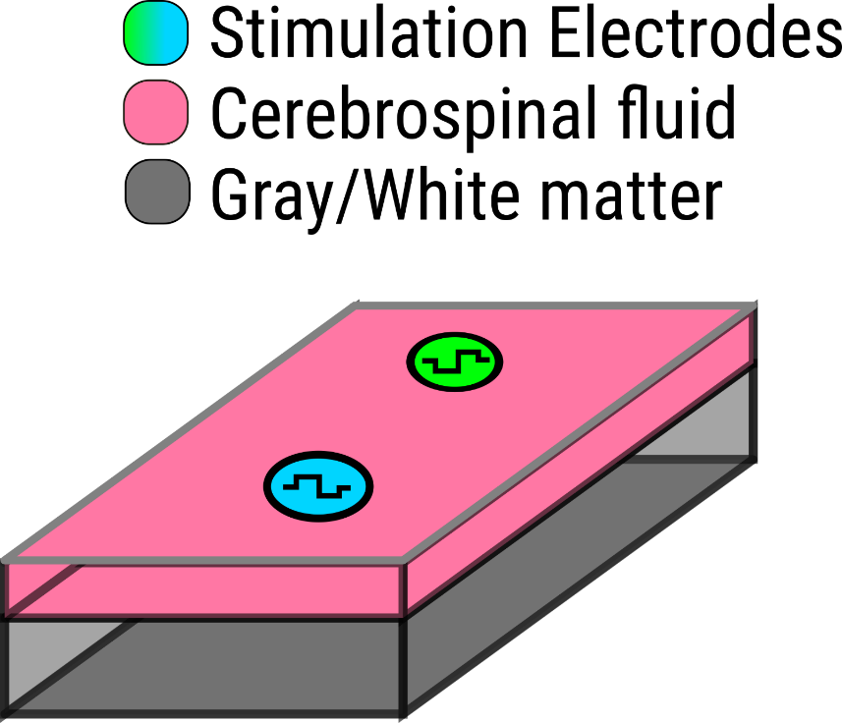
Multilayer analytic model analytic
Future work
Include intraoperative DBS recordings
Extend to recordings with depth electrodes to validate/predict
Parameter space exploration on cluster to obtain range of physiological parameters

Slide 18
Aim 1.2: Extraction of neural signals during concurrent DCS, and open source software and data to aid replication
Aim 1: Modeling cortical stimulation and interpreting its effects on neural dynamics
How do we interpret the brain’s response to DCS?
Continuous stimulation trains make interpretation difficult
Limited tools and data available for validating algorithm performance on stimulation related data sets
Provide code and data to advance artifact processing
6 example data sets already curated
Contributes to efforts across domains (hardware/software) to process neural data with stimulation (MEA + ICMS, EEG + TMS, ECoG)

Slide 19
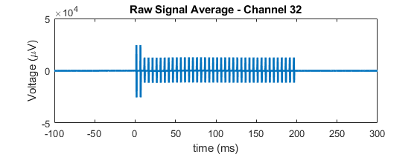
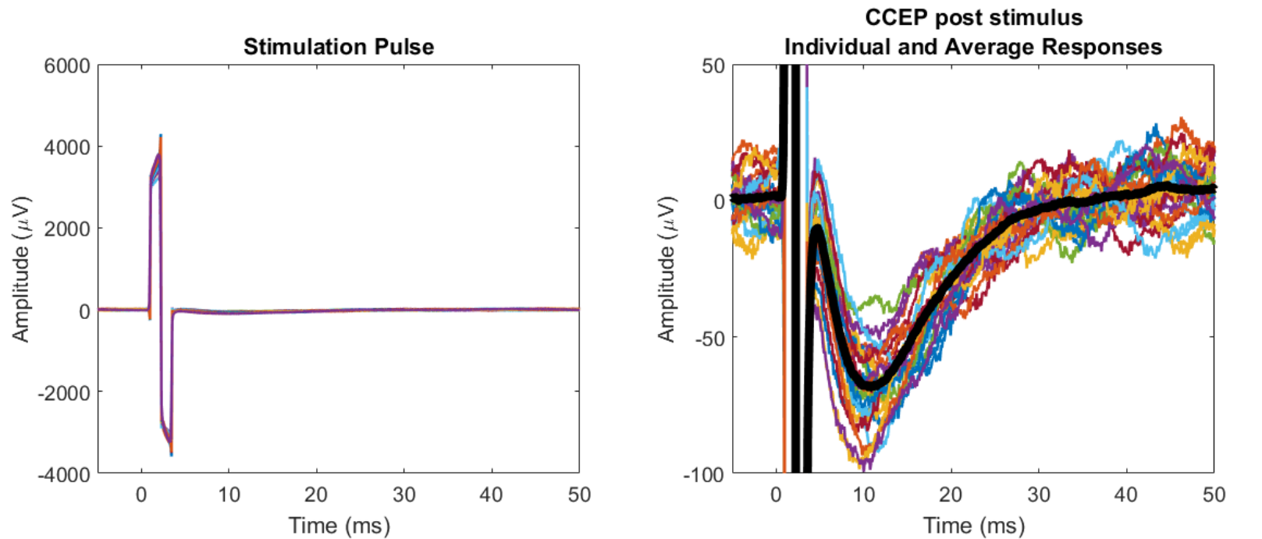
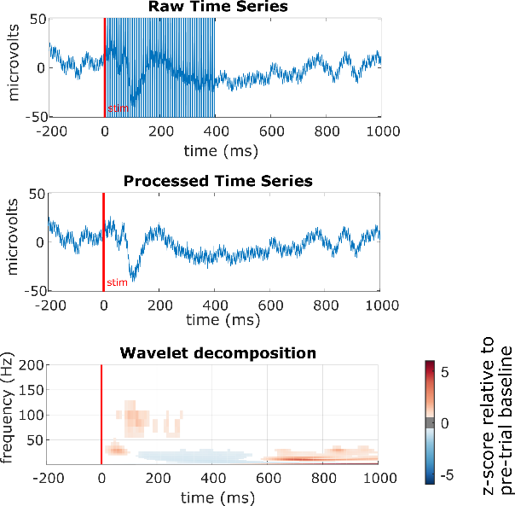



How we understand the cortical response to DCS?
Need to extract the ongoing neural activity to understand the neural response to stimulation
Stimulation artifact complicates traditional analysis
With Jeneva Cronin
Bingni Brunton
Nathan Kutz

Slide 20
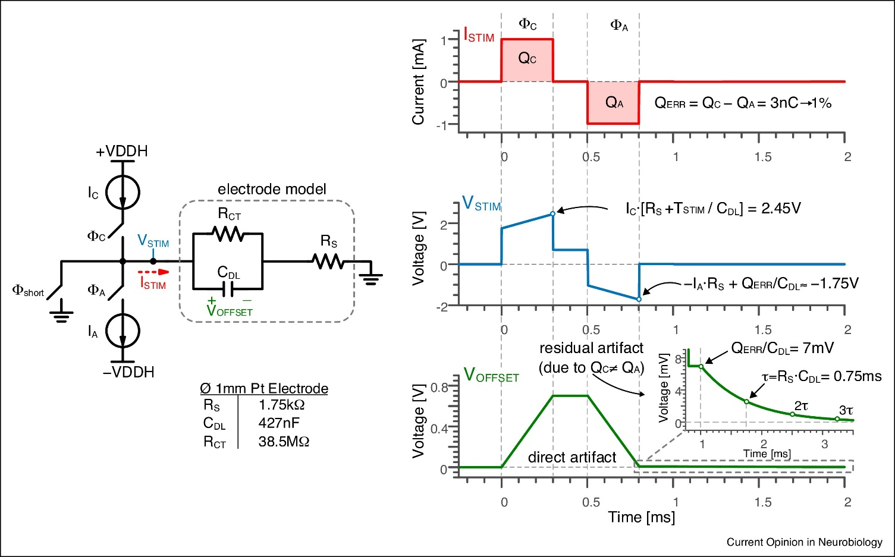
Sources of neural artifacts
Volume conduction through tissue
Linear addition if amplifiers don’t saturate
Residual artifact due to charge imbalance in tissue
Active area of research
Hardware
Software
Zhou A, et al, 2018
Notes:
cut down on methods descriptions
show goals of project, results

Slide 21
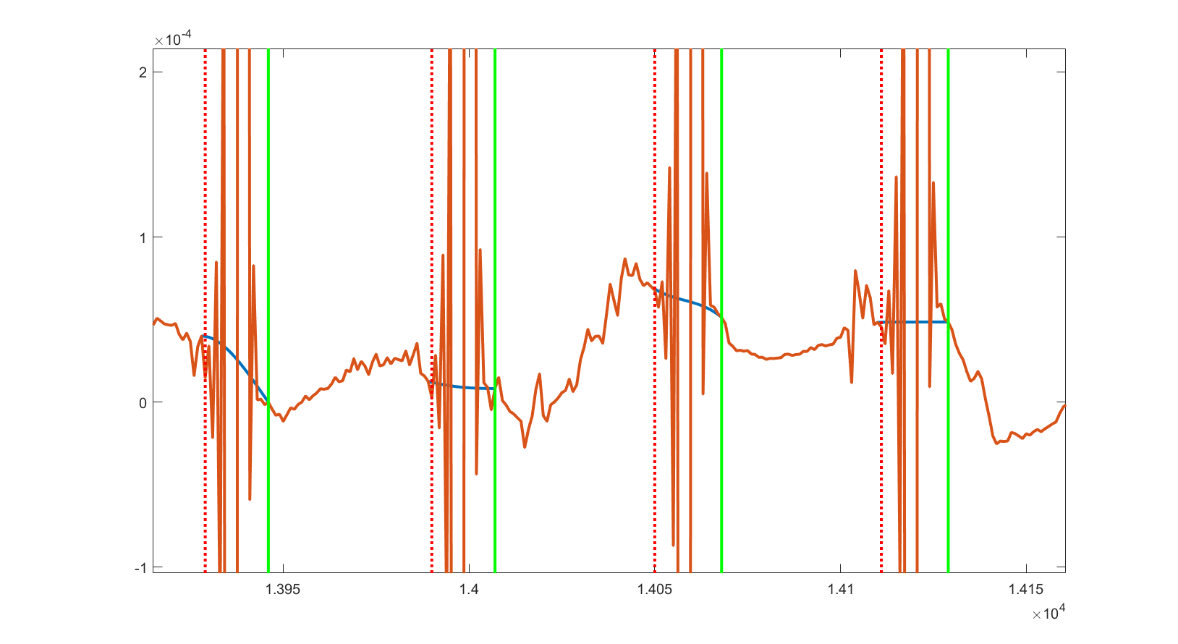
Problems with existing approaches
Linear interpolation eliminates high frequency information
Broadband gamma is an important signal (70-150 Hz)
Simple averaging blurs artifacts
Interpolated
raw

Slide 22

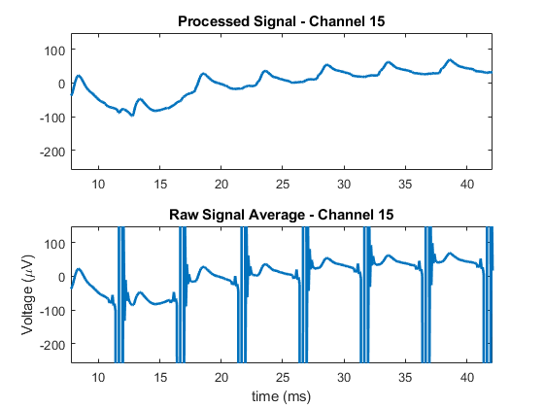
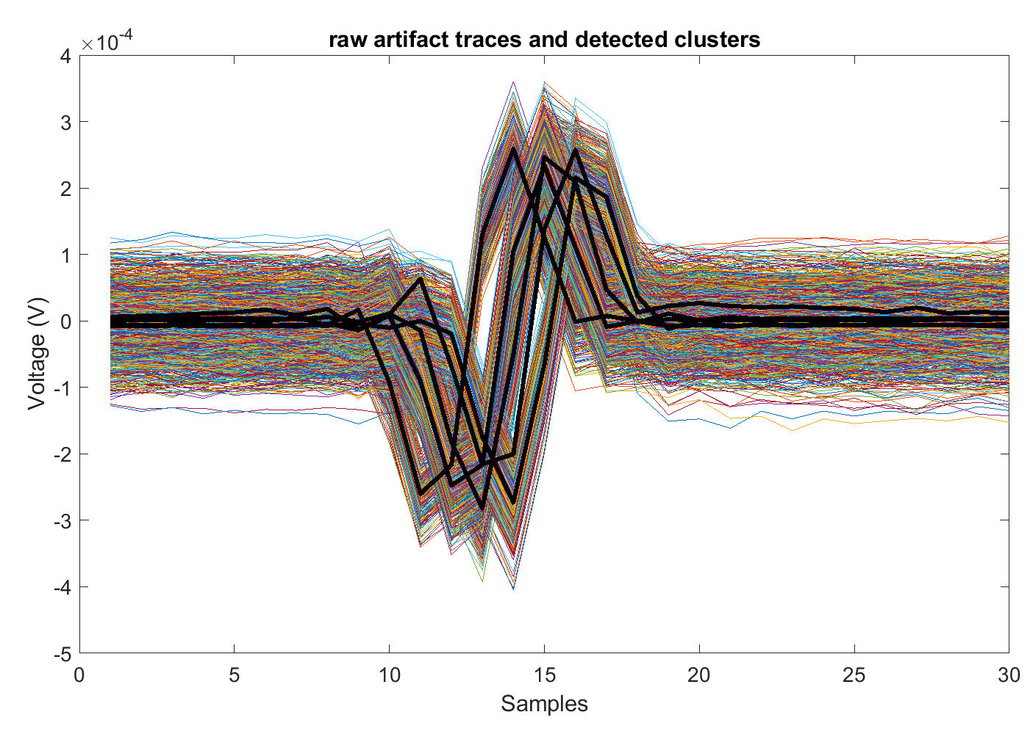
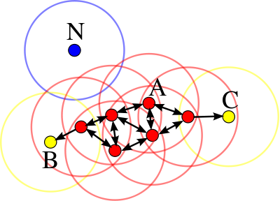
Clustered dictionary based template matching technique
Detect onset/offset of each stimulation (z-score threshold crossing)
Dictionary of artifact templates, channel by channel (DBSCAN)
If there is a finite set, you can remove whichever one matches best
Wikipedia
Notes:
talk about this less

Slide 23
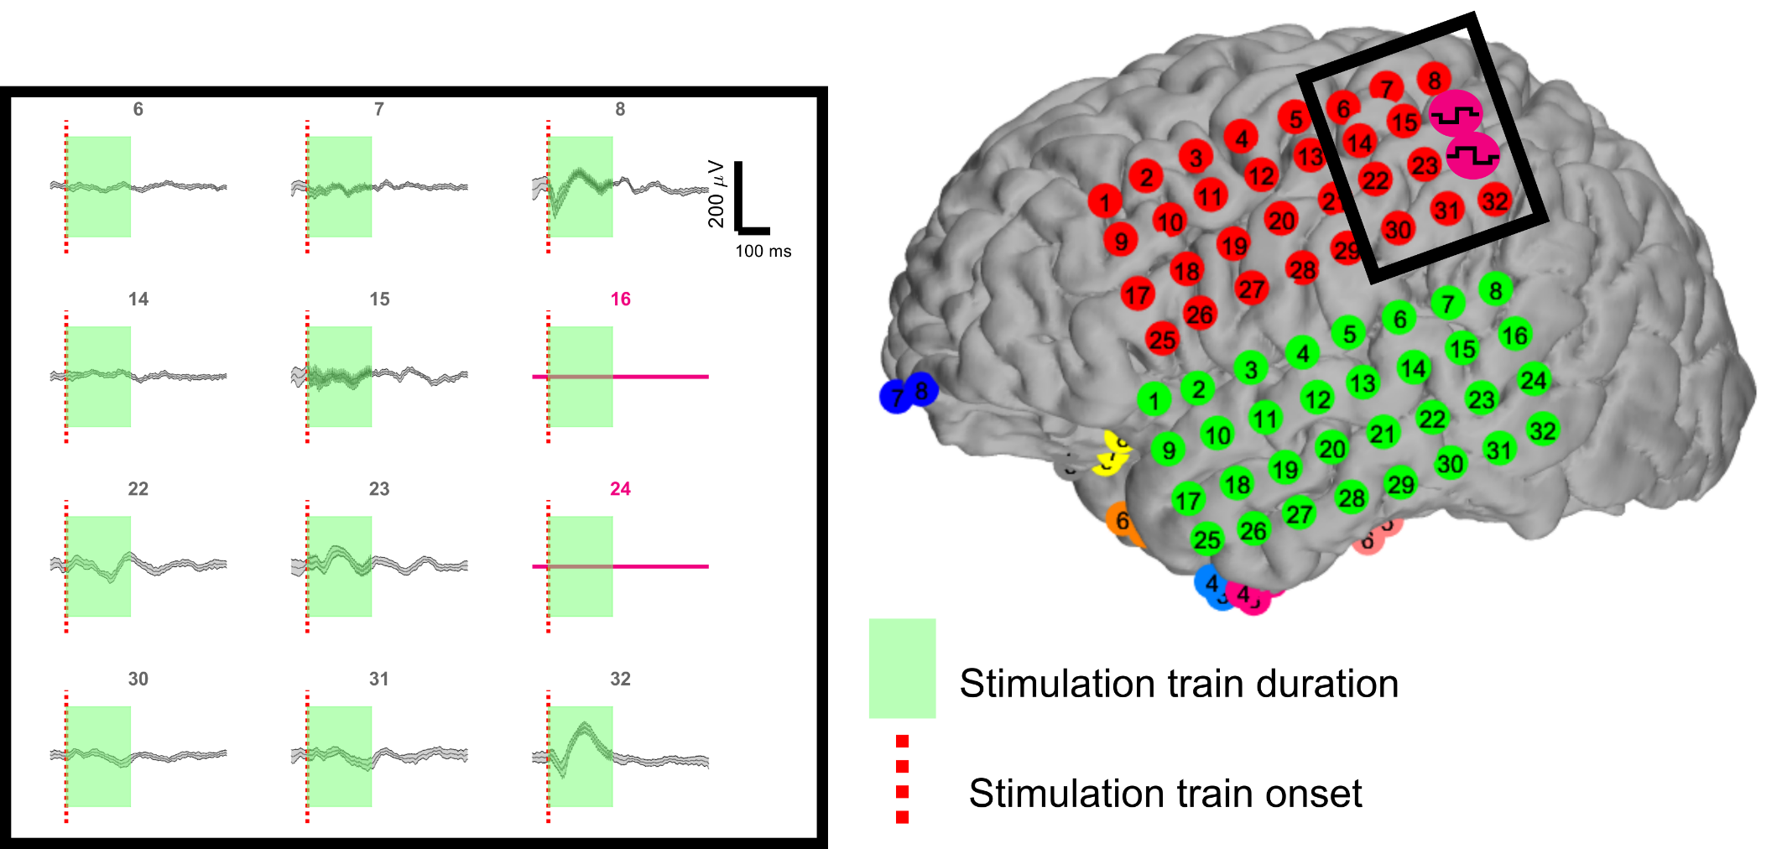
Can now examine time-frequency responses during time windows of stimulation
Record everywhere else
Stimulate here
Recover signals here

Slide 24
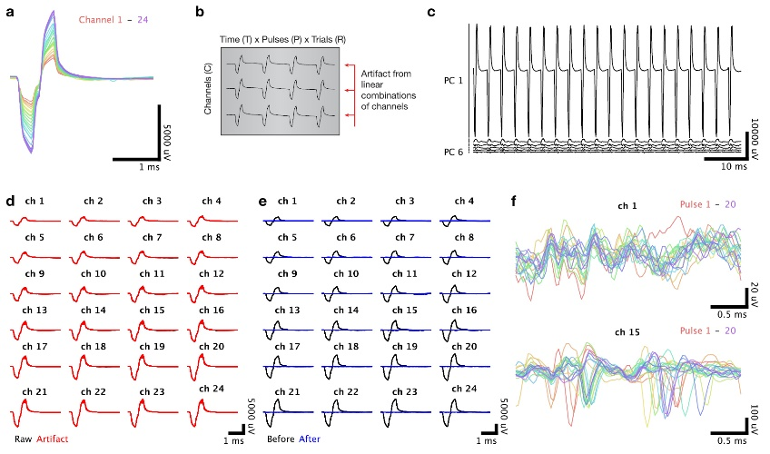
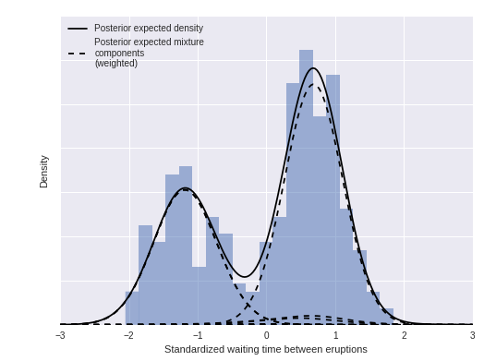
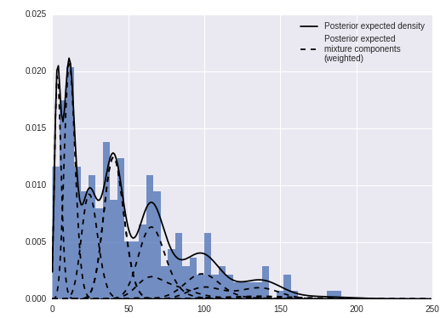
Future work – validation and more advanced methods
Validation
Lomb-Scargle periodogram¹
Synthetic data set²
New techniques
Principal component regression²
Dirichlet Process Mixture Model³
1. Muller L, et al, 2018
2. O’Shea DJ, et al, 2017
3. Teh YW, et al, 2006
4. http://austinrochford.com/posts/2016-02-25-density-estimation-dpm.html
Notes:
belabor this a lot less
get rid of
put DBSCAN on this slide
What's more important
spend less time on details of others

Slide 25
Aim 2.1: Slower response times to trains of DCS relative to natural haptic feedback in the same spatial location
Aim 2: Neural and behavioral effects of cortical stimulation in sensory cortex
How do humans respond behaviorally to DCS compared to natural, haptic feedback?
Slower reaction times to DCS (4 subjects)
Contributes understanding of closed loop neuroprosthetic design criteria and sensory processing

Slide 26
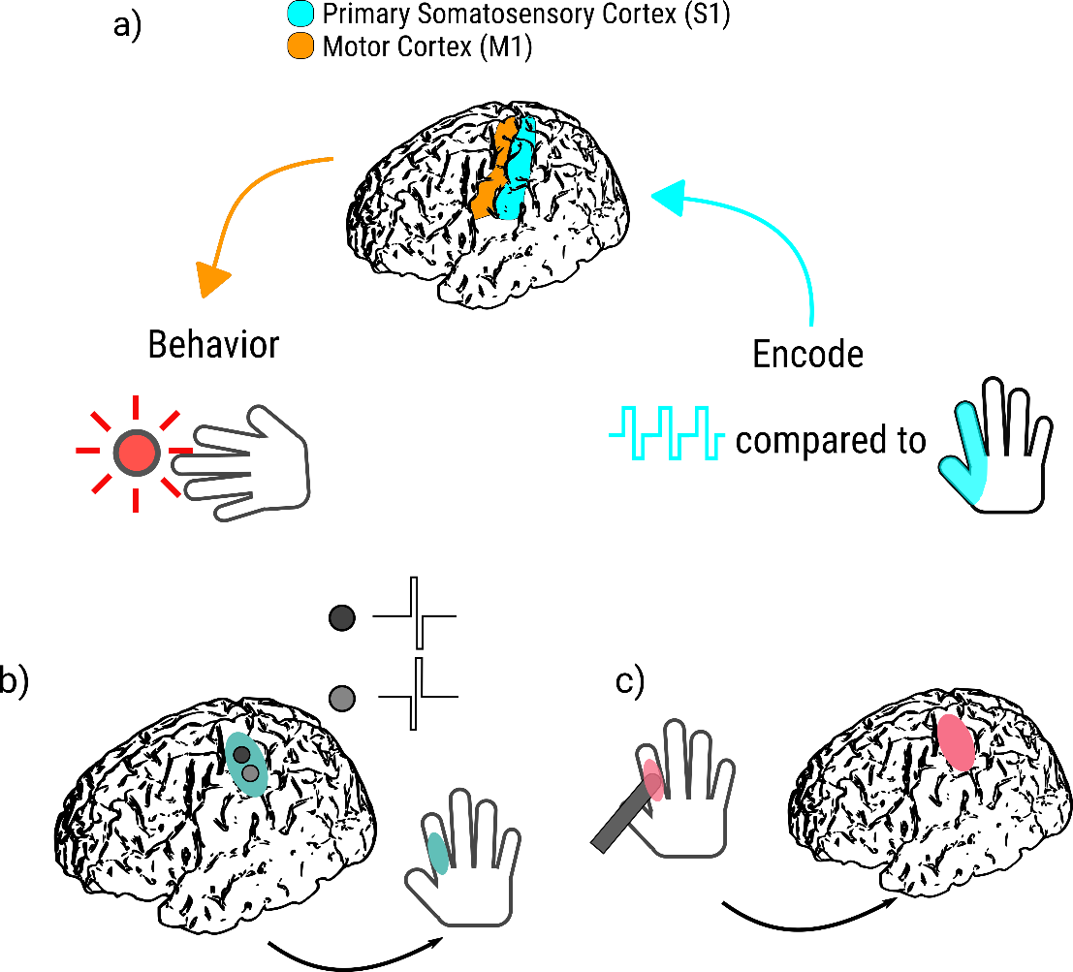


Human cortical response times to natural haptic stimulation and DCS
Restoration of sensory feedback in a BCI application
How do humans respond to feedback through DCS?
Need to understand haptic (natural) compared to DCS (artificial) performance
Jeneva Cronin
Kurt Weaver
Caldwell DJ, et al, “Cortical stimulation results in slower reaction times compared to peripheral touch in humans” in preparation: 2018

Slide 27
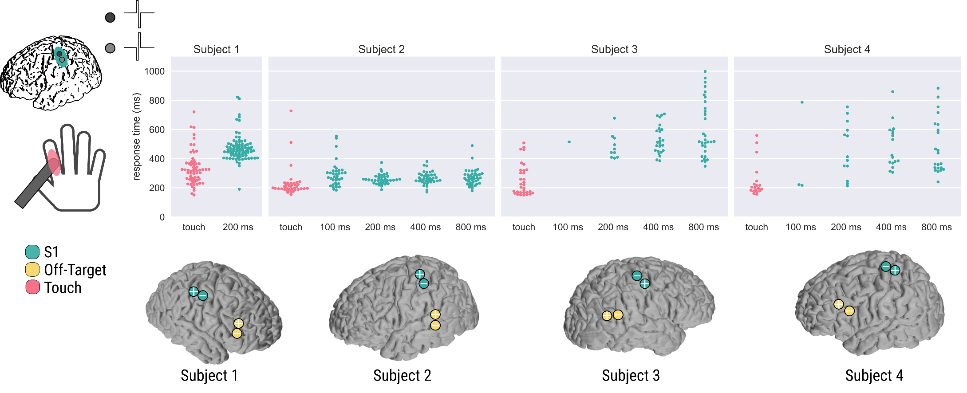
DCS of S1 results in slower response times (RT) relative to natural haptic touch
Differences between these
Different train lengths of DCS (100, 200, 400, 800 ms), all subjects demonstrate significantly slower reaction times to DCS relative to haptic touch, this matches the primate work of (Godlove J, et al, 2014)
Notes:
This is the key takeaway from this graph *** apply this to
a few words to summarize key points
reduce text on slides
artifact processing

Slide 28
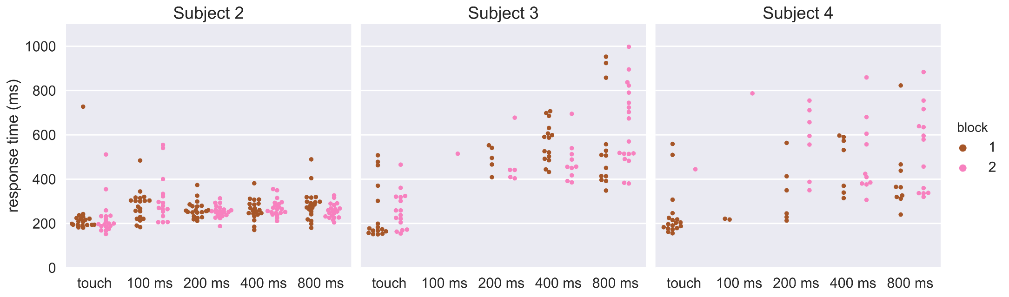
No significant learning or habituation to blocked trials
Differences between these
Although DCS is novel, over a short period minimal learning effects
Suggests that DCS as administered here may always be responded to slower than haptic stimuli
Notes:
Jeff says sensory response is pretty overlearned. Downward trend over time that eric is asking about?
raj says there is no feedback.
Bing says beep to motivate - getting better or worse. Clicker method
david bjanes - temporal dynamics are really slow.

Slide 29
Aim 2.2: Comparisons between temporal dynamics and time-frequency responses to haptic stimuli and DCS in somatosensory cortex
What are the cortical differences between responses to natural haptic stimuli and DCS?
6 subjects (4 simple RT task, 2 waveform modification) collected, 2 to 4 additional subjects with varying waveforms would expand waveforms tested
Contributes to understanding of neural processing of artificial feedback, how to design future stimulation protocols to decrease latency
Aim 2: Neural and behavioral effects of cortical stimulation in sensory cortex

Slide 30
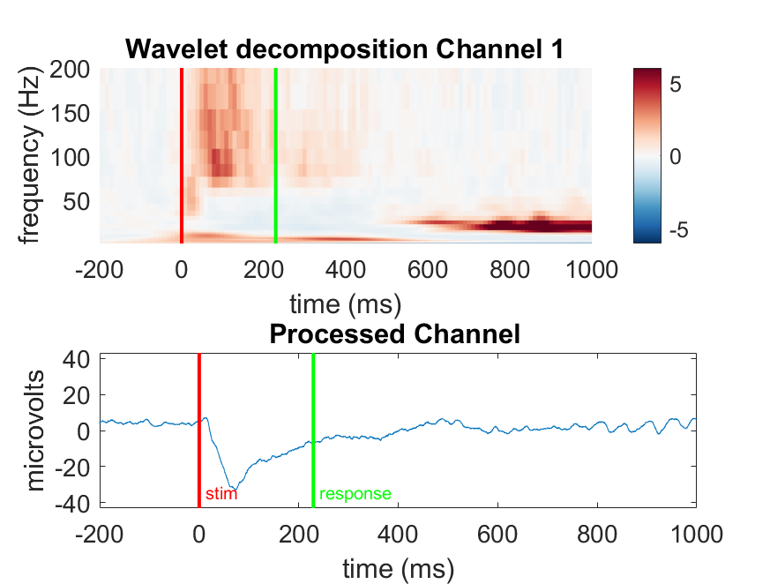
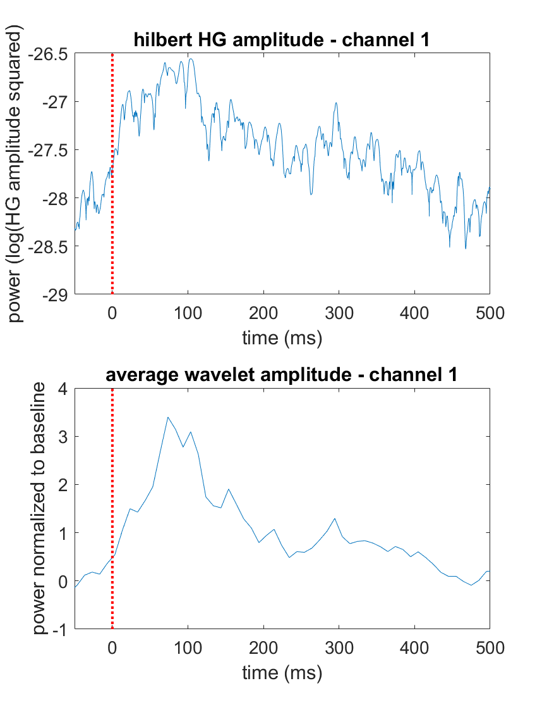
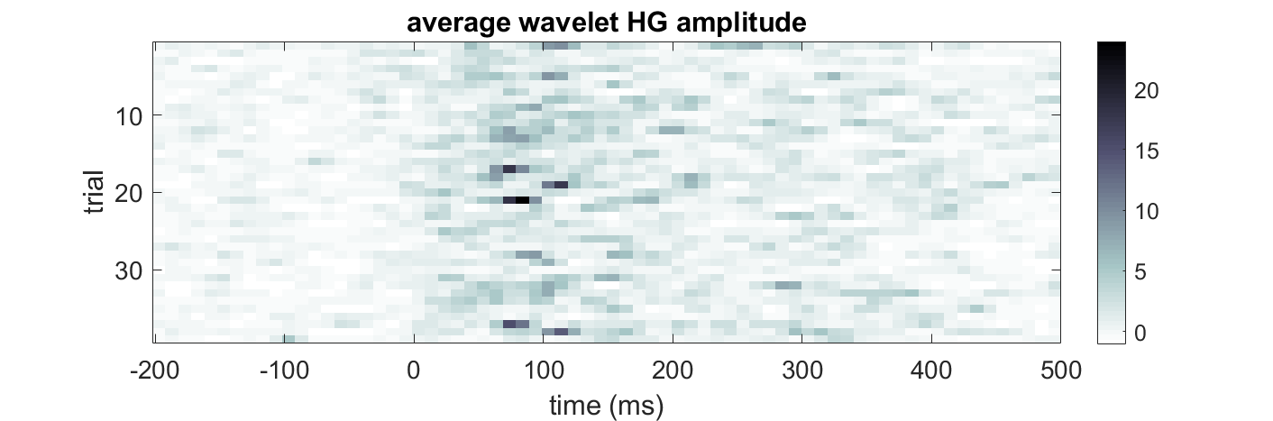
Continuing and future analyses time and frequency domain
Event related potentials (ERPs)
High gamma power (70-150 Hz)
Phase locking value (PLV)¹
Phase amplitude coupling (PAC)²
1. Ai L, et al, 2014
2. Voytek B, et al, 2013

Slide 31
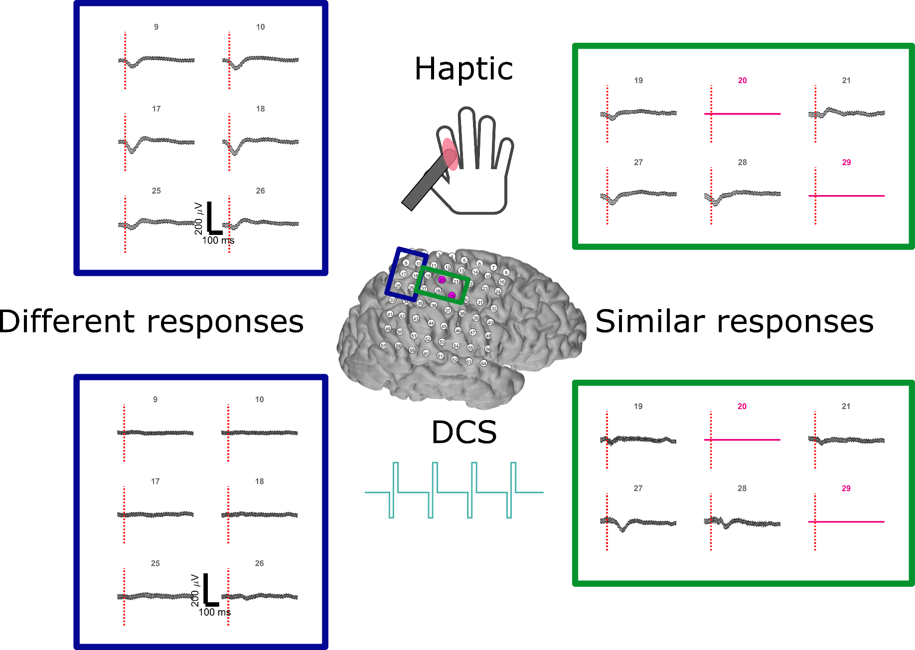
Time series - haptic vs. DCS
Notes:
compare those 2 pulses responses to the long train.
Stimulation parameters - how to get close to natural stimulation response
Dadarlat - something completely artificial, something learn. try and get stimulation as natural as possible. test if there is a particular combination of stimulation parameters. posthoc analysis, the more it is natural, does it approximate the natural response

Slide 32
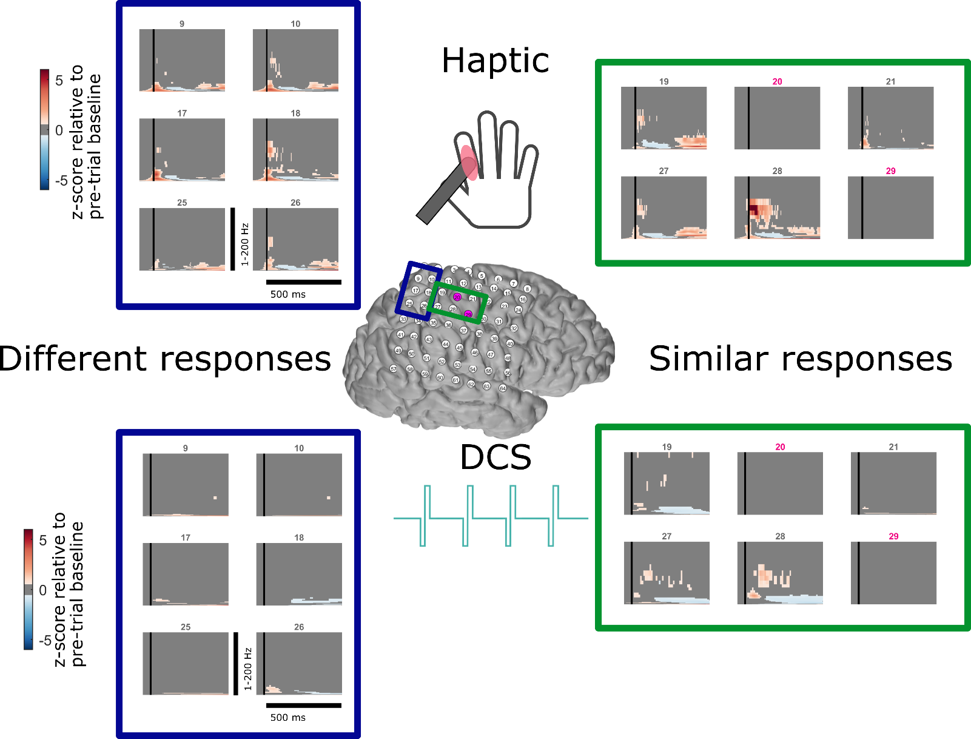
Time frequency - haptic vs. DCS
Notes:
send Bing paper on lomb-scargle periodogram -
DCS - acronym - Chet said
DCES - direct cortical electriacl stimulation
DECS -
ECoS

Slide 33
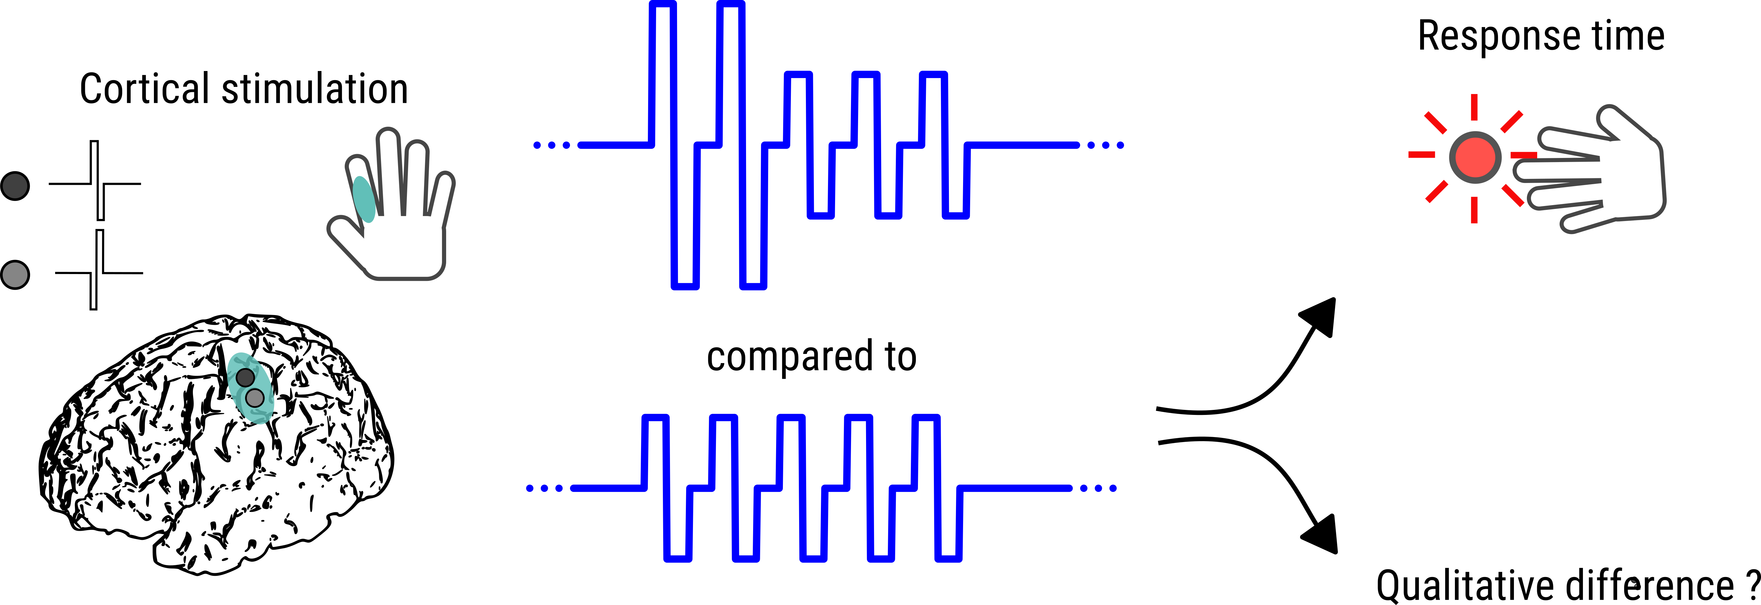
Modifications of the stimulation train inspired by onset/offset signals
What happens as we modify the shape of the waveform?
Can a stimulus train with greater charge initially more naturally activate somatosensory cortical circuitry?^{1,2}
Tabot, GA, et al. 2013
Bensmaia, SJ, et al. 2015

Slide 34
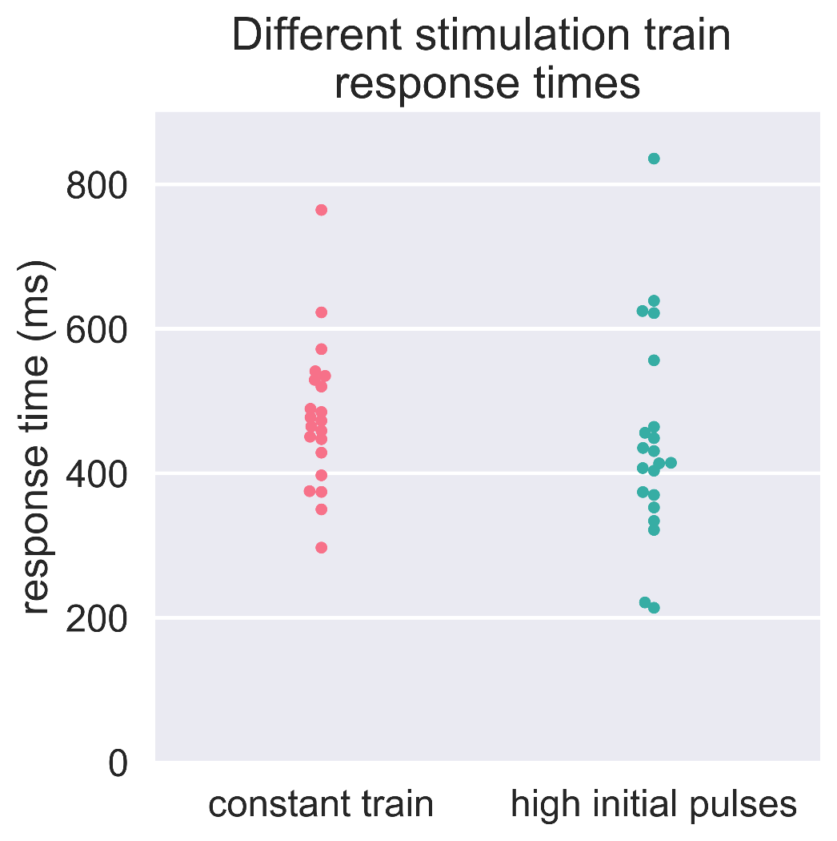
Similar perceptual reports, trend towards faster reaction times
Trend towards faster RT with initial high pulses
(median of 414 vs 473 ms)
No statistically significant difference between groups
Similar perceptual reports

Slide 35
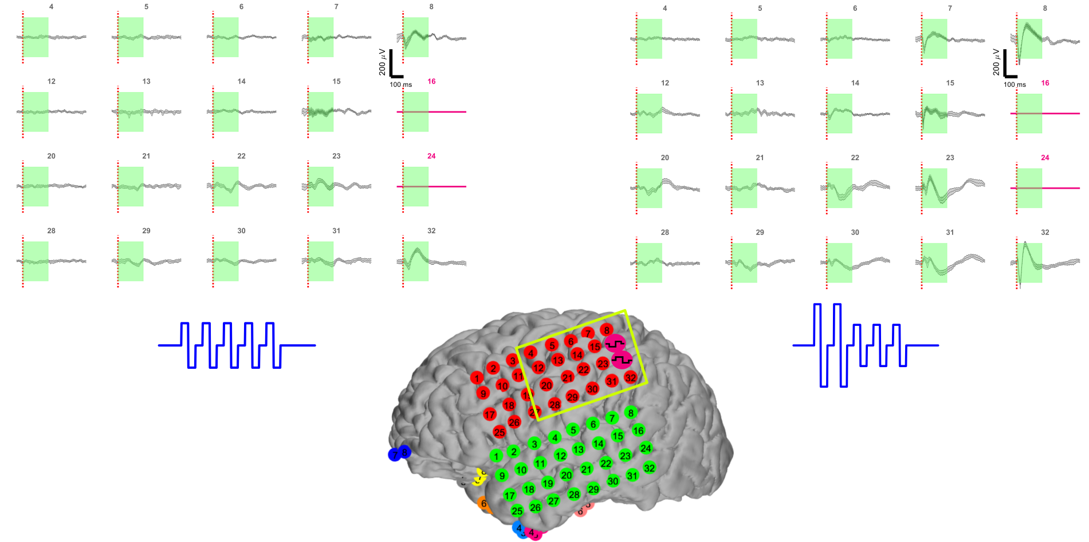
Different size of evoked responses

Slide 36
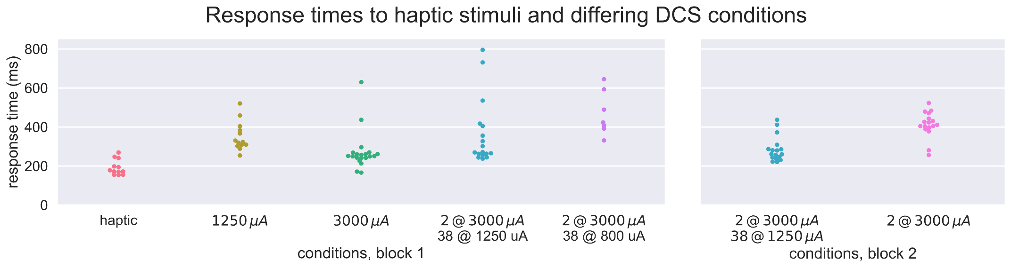
Increased charge delivery decreases RT
All DCS trains are 200 ms trains
2 individual pulses can be perceived
800 μA train not perceived
Notes:
stimulate with higher frequencies, inhibitiory effect might contribute. Higher than 100 Hz, hyperpolarizing neurons.
Chet said they can tell difference between 50-100 Hz
David bjanes different breaks between trains. O'doherty 200 -400 hz, put breaks of start in stop in trains, cueing off of break
David bjanes - talk to him again
Raj - get animal data -
2011/2013 - azadeh - compare predictions to animal data

Slide 37
Aim 2.3: The behavioral and neural effects of temporally simultaneous and spatially overlapping haptic stimuli and DCS
Aim 2: Neural and behavioral effects of cortical stimulation in sensory cortex
What happens behaviorally and neurally when natural and artificial feedback are combined spatially and temporally?
Can they be perceived independently?
Does the difference in response times predict where there will be uncertainty in their timing?
2 subjects collected, 2 to 4 more with one protocol would provide more significance and brain area covered
Contributes to understanding of real world neuroprosthetics where different stimuli modalities will arrive concurrently

Slide 38
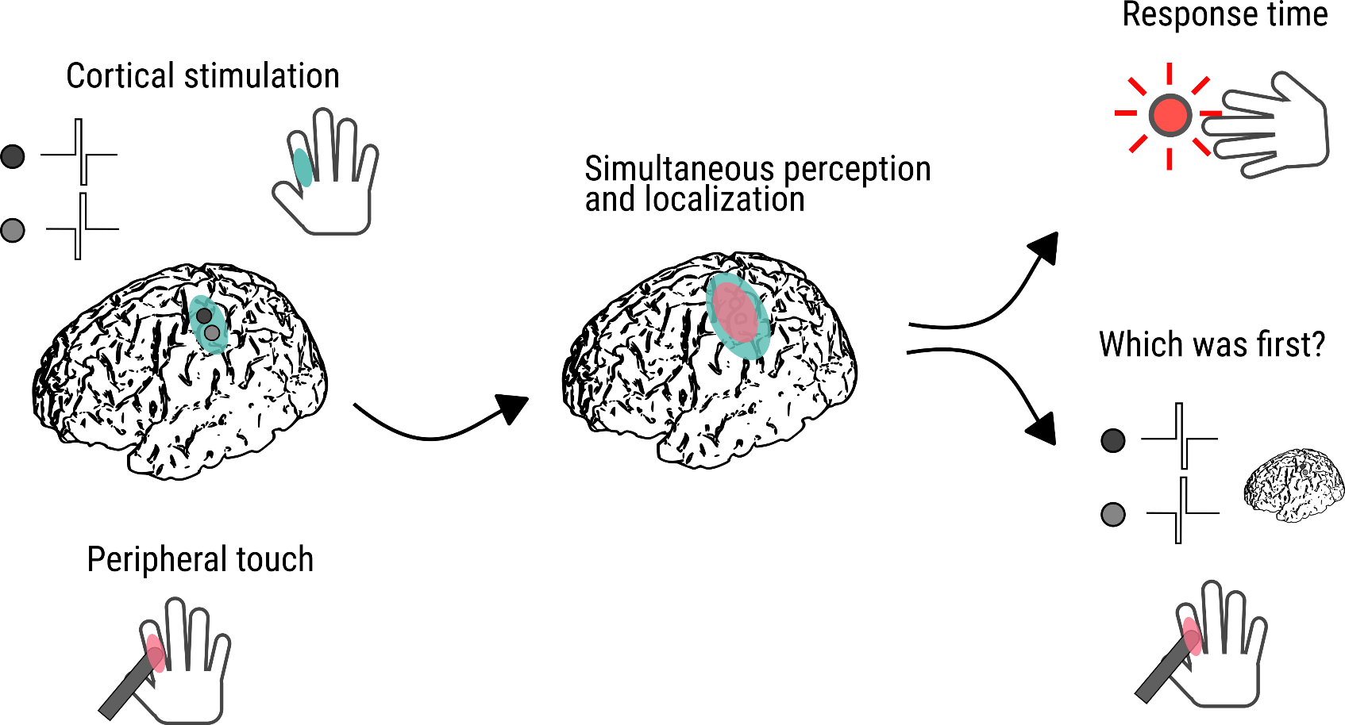
Temporal order judgement task

Slide 39

Temporal order judgement results
DCS must lead natural touch by approximately the lag between them to be perceived as arriving first
Stimulus onset asynchrony (SOA), 50% point on gaussian

Slide 40


Functional MRI correlates of TOJ
fMRI reveals areas of interest
left ventral, bilateral dorsal premotor cortex
left posterior parietal
bilateral premotor cortices
bilateral middle frontal gyri
bilateral inferior parietal cortices and supramarginal gyri
bilateral posterior part of the superior and middle temporal gyri
Analyze neural signals focused on these regions
Takashi T, et al, 2013
Miyazaki M, et al, 2016

Slide 41
Aim 3.1: Beta-oscillation triggered stimulation paradigm to enhance connectivity of beta-synchronous regions
Aim 3: Engineered DCS protocols to induce changes in cortical connectivity, plasticity, and motor output mapping
Based off of prior work with beta-oscillation driven stimulation, can we observe similar effects of stimulation in humans?
Data collected from 7 subjects
Dose dependent enhancement,
Exploration of dependence on phase, connectivity patterns
Contributes to understanding of protocols to engineer plasticity from model systems

Slide 42



Beta stimulation experimental paradigm
Jeremiah Wander
Jared Olson
Caldwell DJ, et al, “Cortical stimulation results in slower reaction times compared to peripheral touch in humans” in preparation: 2018

Slide 43

Measurement of EP
Size of evoked potential 10-30 ms after stimulation, early excitatory component¹
Measure peak, quantify change relative to baseline
1. Entz L, et al, 2014

Slide 44

Randomized Control Stimulation
Playback effect
No statistical significance (ANOVA, Multiple comparisons), within playback
Other than baseline, every beta-triggered statistically different than playback (ANOVA, multiple comparisons).

Slide 45


Real time filtering
Real time filtering (12-20 Hz) + artifact blanking
Real time test of digital filtering
Non linear phase IIR filter

Slide 46

Accuracy of phase delivery (unimodal)
Phase delivery
Non-linear curve fit with sine wave 50 – 0 ms before stimulation
Bootstrap distribution to get an idea of reliability of phase estimate

Slide 47


Accuracy of phase delivery (broad, multiple peaks)

Slide 48

Effect across subjects
Current conclusions
Dose dependent effect
Phase is not biggest factor, but may matter
Future work
Characterize changes in resting state connectivity (enhancement in beta, decrease in other frequencies)
Correlate accuracy of phase delivery with magnitude of effect

Slide 49
Aim 3.2: Paired pulse stimulation to enhance connectivity between two cortical sites
Can a paired pulse paradigm enhance connectivity between two cortical sites in humans and demonstrate an increase in functional output (muscle activity)?
1 subject collected, 4 more for validation of single parameter, 8 for different parameters
Contributes to understanding of simple plasticity protocols (no activity dependence), and potential to use MEP output to correlate with plasticity in humans
Aim 3: Engineered DCS protocols to induce changes in cortical connectivity, plasticity, and motor output mapping

Slide 50








Paired pulse conditioning in DBS patients
Intraoperative DBS placement
ECoG strip placed temporarily
Can perform somatosensory evoked potentials (SSEPs)
Locate central sulcus
Motor evoked potentials (MEPs)
Assess cortical excitability / changes in plasticity

Slide 51

Paired pulse conditioning and connectivity assessment - facilitation

Slide 52


Paired pulse conditioning and connectivity assessment - depression
Seeman S, et al, 2017

Slide 53
Aim 3.3: EMG triggered stimulation to remap motor cortex output
Aim 3: Engineered DCS protocols to induce changes in cortical connectivity, plasticity, and motor output mapping
Can EMG triggered stimulation enhance connectivity between two sites in motor cortex and change motor output patterns?
With 2 subjects, validation of protocol, 5 subjects, more comprehensive results on generalizability
Contributes to understanding of different activity dependent signals for plasticity induction

Slide 54


EMG triggered stimulation changes motor output
Lucas T, Fetz E, 2013

Slide 55

EMG triggered stimulation in humans
Trigger off EMG amplitude over threshold (site A, biceps region) in electrodes for different region (site B, deltoid)
Stimulate MEPs at site A, observe muscle response similar to site B
(dynamic time warping, hierarchical clustering¹ on EMG)
Measure EPs at site A, site B
1. Aghabozorgi S, et al, 2015

Slide 56
Thesis Contributions
Aim 1:
Complementary approaches to complicated FEM models
Better understanding of resistivities of cortical layers for modeling
Additional methods, data sets for processing stimulation related data
Aim 2:
Understanding of behavioral and neural processing of DCS
Comparisons to natural feedback within same subject
Different engineered DCS protocols and their effects
Understanding of real world scenario of concurrent feedback
Aim 3:
Testing of various stimulation protocols previously demonstrated in model systems
Moves protocols towards clinical trials

Slide 57
Timeline
June - July 2018 : Write paper on analytic model for stimulation voltage currents
Sufficient data has been collected
August 2018 : Submit oscillation triggered plasticity paper
Sufficient data has been collected
June - February 2019 :
ECoG patient data collection
waveform modification subject – 2 to 4 subjects
temporal order judgement task - 2 to 4 subjects
EMG triggered stimulation -2 pilot subjects validate protocol, 5 subjects generalize
DBS subject data collection
4 to 8 pair pulse stimulation subjects to assess viability of MEPs, extent of parameters tested
January 2019: Establish reading committee
January-February 2019: Write paper on differences between natural and cortical feedback
January-February 2019: Write paper on temporal order judgement and subjective judgement
March - May 2019: Write dissertation
Beginning of May 2019 (3 weeks prior to exam): Dissertation sent to all committee
members
May 30 2019: Dissertation Defense

Slide 58











Thank you! Acknowledgments
University of Washington
Jeffrey Ojemann
Rajesh Rao
Bingni Brunton
Nathan Kutz
Larry Sorensen
Jeneva Cronin
Kurt Weaver
Nile Wilson
Clark Kuo
Jared Olson
Andrew Ko
Jeremiah Wander
Nancy Wang
James Wu
Kaitlyn Casimo
Brandon Yee
Gabriel Obregon Devapratim Sarma
Brady Houston
Northeastern
Dana Brooks
Kimia Shayestehfard
University of Utah
Rob MacLeod
Moritz Dannhauer
University of Freiburg
Tonio Ball
Alexis Gkogkidis
Notes:
Contributions slide - what would my major contributions
what are collateral contributions - results to DBS, ECoG
Individual aims - break down what already has done, break timeline down for each aim, at different

Slide 59
Supplemental slides

Slide 60

Origins of high gamma
Miller KJ, et al, 2009

Slide 61

Optical imaging of DCS
Borchers S, et al, 2012

Slide 62
Aim 1.1: Creation of interpretable, analytic models that explain the resistivities of various cortical layers

Slide 63

Two separated electrodes

Slide 64

Multilayer equations
Constant voltage finite size circular electrode – V(r) is voltage on the surface away from the electrode
Schumann G, et al, 1969

Slide 65

Comparison to FEM

Slide 66
Aim 1.2: Extraction of neural signals during concurrent DCS, and open source software and data to aid replication

Slide 67



Dirichlet process mixture model
El-Arini K, 2008

Slide 68
Dirichlet process mixture model
http://austinrochford.com/posts/2016-02-25-density-estimation-dpm.html

Slide 69



(3) Artifact isolation
Motivation:
Stimulation artifact 1000x greater than evoked potentials
Cannot filter or perform traditional time-frequency analyses

Slide 70

ICA components on a trial by trial basis
Isolate components
Certain peak prominence
Occur within stimulation window
Currently requires tuning, scaling

Slide 71



Example of original signal vs. extracted signal
Artifact largely eliminated
Signal underneath appears preserved
Not perfect removal

Slide 72


Wavelet analysis example
Trial by trial time frequency analyses
Notch filtering

Slide 73


Procrustes distance metric trial by trial
Trial by trial analysis (10 trials here)
Stimulation channels excluded
Channel variability
Future work to determine cutoff, applicability across data sets
Worse
Stimulation
electrodes
Better

Slide 74
Aim 2.1: Slower response times to trains of DCS relative to natural haptic feedback in the same spatial location

Slide 75



Characterizing the touch probes
Notes:
Contact Henrik ehrsson – email Arvid
Pneumatic would be better
Fill out this curve!!!!!

Slide 76
Aim 2.2: Comparisons between temporal dynamics and time-frequency responses to haptic stimuli and DCS in somatosensory cortex

Slide 77
Aim 2.3: The behavioral and neural effects of temporally simultaneous and spatially overlapping haptic stimuli and DCS

Slide 78

From: Neural Correlates of Tactile Temporal-Order Judgment in Humans: an fMRI Study
Cereb Cortex. 2012;23(8):1952-1964. doi:10.1093/cercor/bhs179
Cereb Cortex | © The Author 2012. Published by Oxford University Press. All rights reserved. For Permissions, please e-mail: journals.permissions@oup.com
Notes:
Figure 5. Brain areas activated by TOJ (red), random-dot motion (blue), and a listening task (green). (A) Lateral views. (B and C) Activations on 2 transverse planes at z = + 6 mm (B) and +42 mm (C). Activation maps are shown in red for the TOJ > NJ contrast (the same conjunction analysis as in Fig. 4), in blue for the motion > no motion contrast during the task involving moving random dots, and in green for the forward replay > reverse replay contrast during the narrative listening task. All contrasts were thresholded at P = 0.05 (uncorrected). White represents commonly activated area in TOJ > NJ overlapped with the area activated by the moving random dots. Note the overlap in the posterior regions of the bilateral middle temporal gyri (B), and in the bilateral dorsal premotor cortices and in the bilateral inferior parietal cortices (C). The x signs in (B) represent the standard locations of the human V5/MT (a: [−46, −66, 8] (Dukelow et al. 2001), b: [−46, −78, 6] (Kolster et al. 2010), c: [−55, −74, 4] (Orban et al. 2003), and d: [−46, −73, 3] (Watson et al. 1993) in the MNI coordinates). The yellow dots in (B) represent reported peak activations in response to biological motion stimuli (1: [−55, −21, 7], [61, −24, 6] (lip-reading, Calvert et al. 1997), 2: [−46, −71, 8], [47, −59, 9] (gaze, Wicker et al. 1998), 3: [−48, −55, 7], [54, −50, 3] (gaze, Puce et al. 1998), 4: [−50, −52, 4], [55, −50, 3] (mouth movement, Puce et al. 1998), 5: [−47, −57, 14], [55, −65, 5] (gaze, Hoffman and Haxby 2000), and 6: [51, −36, 5] (hand movement, Grezes et al. 1999). The x signs in (C) represent the same locations in the human VIP as in Figure 4.
78

Slide 80
Aim 3.1: Beta-oscillation triggered stimulation paradigm to enhance connectivity of beta-synchronous regions

Slide 81

Rhythms in the brain
Idea of “Beta-Rhythms”
12-25 Hertz
Representative of synchronous neural activity across the cortex
Neural Correlate of attention
Transient synchronization
http://itsusync.com/different-types-of-brain-waves-delta-theta-alpha-beta-gamma
Murthy VN, Fetz EE. 1996a, 1996b

Slide 82

Non-human primate work from Fetz lab
Stimulation during depolarizing phase – strengthen synaptic strength
Stimulation during hyperpolarizing phase – weaken synaptic strength
0.5 mm exposed tip (0.06mm² area) epidural electrodes
Zanos S.. 2013.

Slide 83


How do we measure short term plasticity changes?
Cortico-cortical evoked potentials (CCEP)
Early component (10-50 ms post stimulation) - excitatory
Late component (100-300 ms post stimulation) – inhibitory
Measure modification of these
Keller CJ, et al, 2014

Slide 84

(1) Beta stimulation project
Motivation: Enhance connections in the brain for neurorehabilation
Goal: Test a spontaneous beta-oscillation driven closed loop stimulation protocol to modify short term plasticity in humans

Slide 85



Beta stimulation experimental paradigm
Olson JD*, Caldwell DJ*, et al. “Dose dependent enhancement of Cortico-Cortical Evoked Potentials during Beta-Oscillation Triggered Direct Electrical Stimulation of Human Cortex”,
In Preparation
*These authors contributed equally

Slide 86




Calculating phase of delivery
Method:
Levenberg–Marquardt algorithm
Fit sine wave (10-30 Hz) from 50 ms before to the time of stimulus on the raw and causal beta filtered signal
Estimate instantaneous delivery phase
Some subjects within 4° of phase delivery on average – others 100 °

Slide 87

Spatial selectivity – no clear phase dependence
Channels adjacent to stimulation sites
Do not always show evoked potentials
Effective connectivity
Example of no clear phase dependence
Both 90, 270° show effect

Slide 88

CCEP magnitude trend depending on number of conditioning stimuli
Dose dependent effect
Across subjects
Phase not as important as in primate studies
Different electrode sizes, lengths of experiments, numbers of sessions
11% increase in CCEP magnitude

Slide 89

ANOVA results across subjects and phase
Variability:
Size of response
Degree of response
Why?
Electrode placement
Subject differences
Ongoing brain state
Medication status

Slide 90

Playback condition – does beta matter?
Playback effect
No statistical significance (ANOVA, Multiple comparisons), within playback
Other than baseline, every beta-triggered statistically different than playback (ANOVA, multiple comparisons).
Significant difference between subjects
Why higher baseline?

Slide 91
(1) Beta triggered stimulation summary
7 subjects
Transient increase in CCEP magnitude
Individual subject variability
No clear phase dependence
Smaller effect without beta oscillation

Slide 92
Aim 3.2: Paired pulse stimulation to enhance connectivity between two cortical sites

Slide 93


Pre vs . post

Slide 94


Slide 95
Aim 3.3: EMG triggered stimulation to remap motor cortex output

Slide 96
Other work

Slide 97

Neural data exists in a high-dimensional space
Represent connectivity data as data matrix
Across frequencies, between channels
Can be directional, complex valued

Slide 98


Slide 99

Beta Stimulation Brain Compilation

Slide 100

Physiology of Cortico-Cortical Evoked Potentials
Keller CJ, Honey CJ, Mégevand P, Entz L, Ulbert I, Mehta AD. Mapping human brain networks with cortico-cortical evoked potentials. Philos Trans R Soc Lond B Biol Sci. 2014;369(1653). doi:10.1098/rstb.2013.0528.

